Slide 1


Risk and Resilience for the Grid:
Thresholds and Tipping Points
James Newcomb
Understanding Risk; Boulder CO, October 2015

Slide 2
Resilience and the electric Power grid
How should we think about thresholds of risk for the electricity system?
How can local communities mitigate the risk of grid outages? What are the thresholds of response?
How does electricity system planning link to other resilient system considerations?

Slide 3
Brittle Power: Risks to the Power Grid
Risks to grid security are diverse, with effects at widely varying scales; some small and frequent, others large and infrequent.
Severe weather or fire events: ice and wind storms, hurricanes, tornadoes, heavy snows, wildfires
Geomagnetic disturbances (GMD): solar flare damage to transmission grid and extra high-voltage transformers
Electromagnetic pulse (EMP): high altitude nuclear explosion or other weaponized magnetic pulse device
Physical attack: substation and transmission line vulnerabilities, large-scale power plants (e.g., Metcalf substation)
Cyber threats: attacks on SCADA systems and industrial control systems
Operational accidents: utility operations

Slide 4

Risk and Resilience

Slide 5
Metcalf Substation Attack
"Destroy nine interconnection substations and a transformer manufacturer and the entire United States grid would be down for at least 18 months, probably longer.”
Federal Energy Regulatory Commission 2013

Slide 6
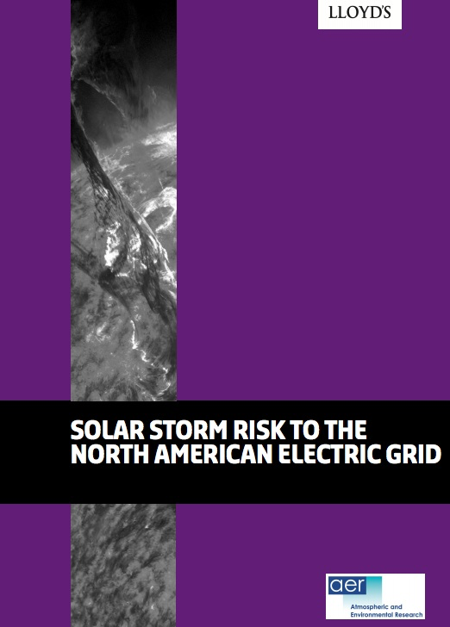
Low Probability High consequence events
“Historical auroral records suggest a return period of 50 years for Quebec-level storms and 150 years for very extreme storms, such as the Carrington Event that occurred 154 years ago…
“The total U.S. population at risk of extended power outage from a Carrington-level storm is between 20-40 million, with durations of 16 days to 1-2 years.
“The total economic cost for such a scenario is estimated at $0.6-2.6 trillion.”
Lloyds, 2013

Slide 7
Microgrids and distributed Energy Resources provide “islandable” power supply

Slide 8
Costs of Distributed Resources are Declining
Levelized Cost of Electricity
Select Technologies ($/MWH)
Source: Bloomberg New Energy Finance

Slide 9
Solar PV and Battery storage: New options
Historical prices (USD/W, USD/Wh)

Slide 10
Critical infrastructure planning
Integration of clean distributed electricity supply resources into the grid can be done in ways that significantly enhances resilience
Community microgrids offer options for providing islandable power supply for critical facilities
Integration of distributed power generation with electrification of transportation diversifies transportation system risks
Distributed energy resource deployment can accelerate carbon emissions reductions
Efficiency and demand response make the local grid more adaptable and resilient in the face of extreme weather events
Distributed power supply resources can support emergency communications

Slide 11
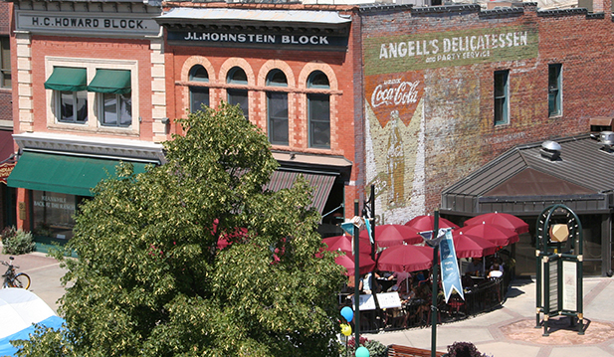
Fort Collins: Resilience and Climate ACtion

